Slide 1


Digital Design Lab Assignment
Dhruv Maheshwari
Kshitiz Bansal

Slide 2
Project Question
Write a Verilog code and testbench which measure the intensity of ambient light (as a input BCD number between 0 to 50) and display it digitally using 16 bit number.
Link: https://www.edaplayground.com/x/CrAa

Slide 3
Flowchart
Input a 8 bit number
else
out = null
input [7:0] bcd, output [15:0] out, reg [7:0] binary
if (bcd[3:0]<4’b1010)
binary=(bcd[7:4]*4’b1010) + {4’b0000, bcd[3:0]}
out = (binary/50) * ($2^{16} −1)$
out = (binary/50) * (2^16 −1)

Slide 4
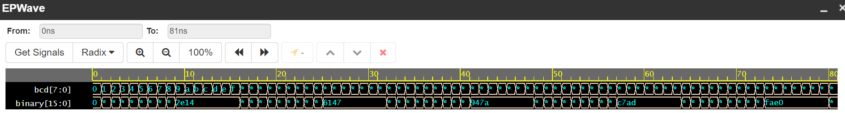
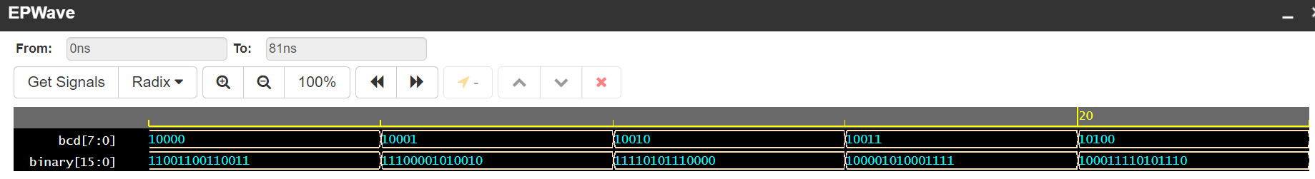
Waveforms

Slide 5
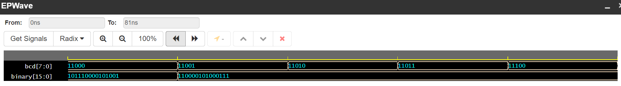
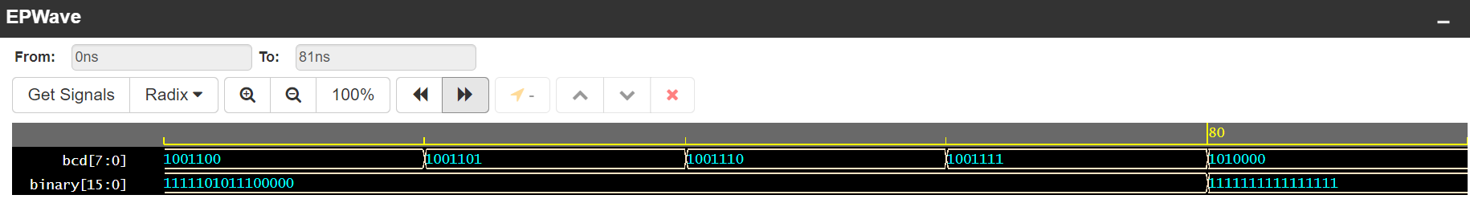
Waveforms

Slide 6
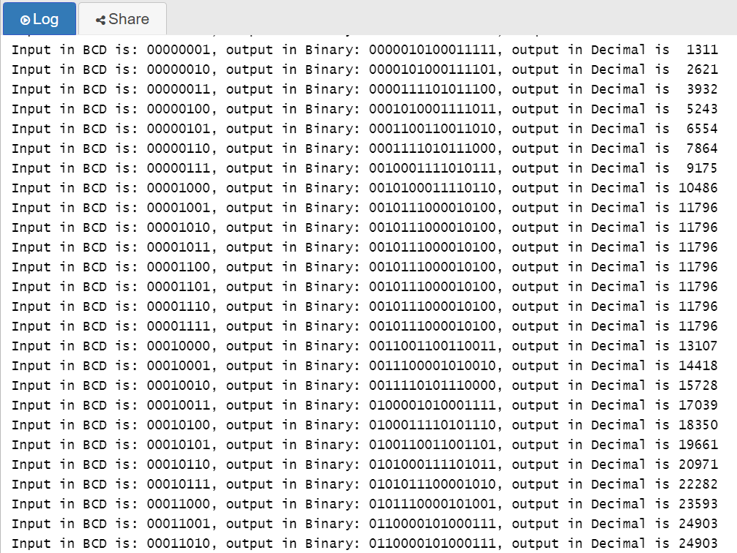
Log window

Slide 7

Video demonstration

Slide 8
Thank you!

